Slide 1
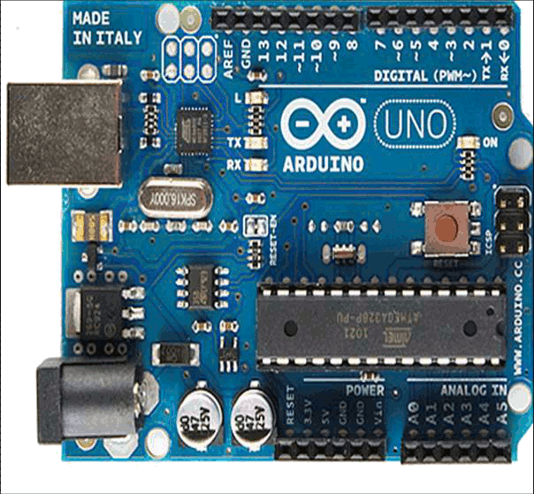
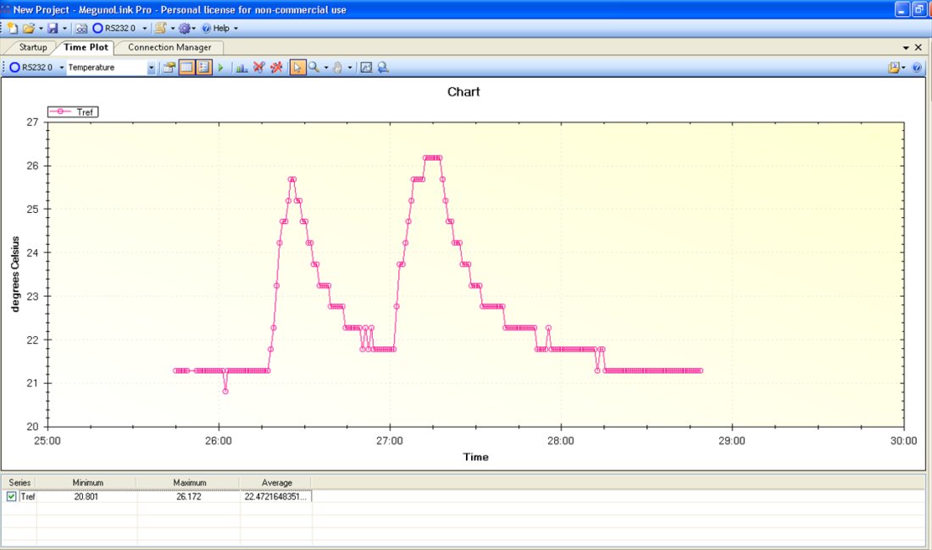
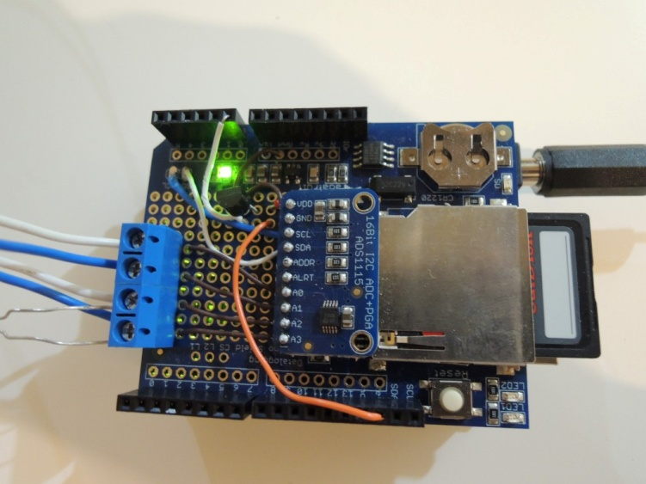
Next steps with Arduino –

Slide 2

Agenda – Using Arduino for lab work
Case Study: presenting and logging temperature measurement (Data Logger)
Timing: millis()
Real Time Clock (RTC)
Arduino communication types: I2C
SD library
Arduino communication types: SPI
Serial monitor (or similar)
Ethernet and Wifi
GSM module
Bluetooth module

Slide 3
Agenda – Using Arduino for lab work
Basics – Review/Questions
Analog Vs. Digital
Presenting data graphically
Data-Transfer protocols
Data-logging
Installing Libraries
Communication methods

Slide 4
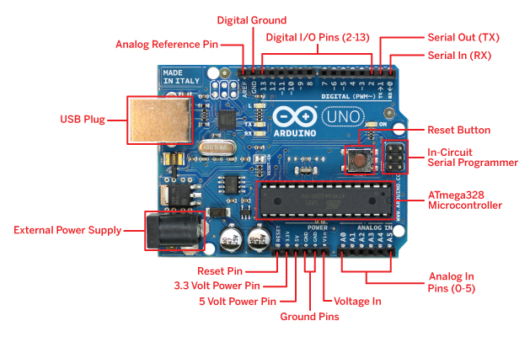
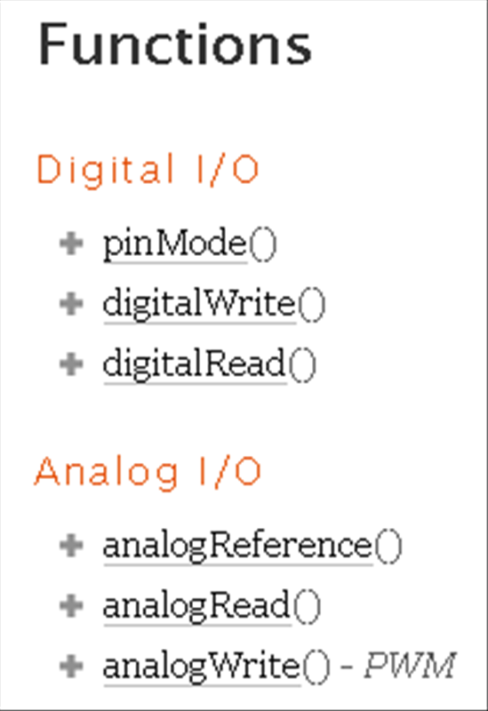
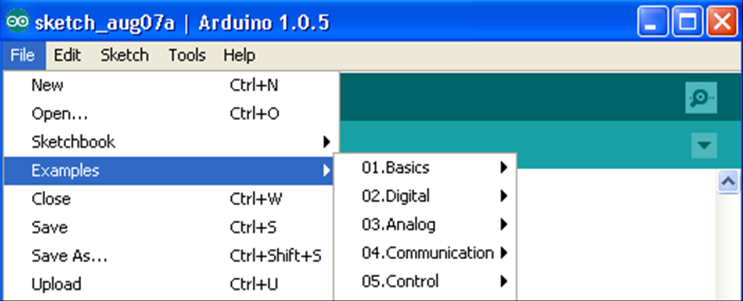
Analog Vs. digital
digitalWrite(led, HIGH); // turn the LED on (HIGH is the voltage level)
Reference:
Examples:

Slide 5
Analog and digitals pins
Digital pins: (http://arduino.cc/en/Tutorial/DigitalPins)
input and output (I/O); initialization: pinMode(pin, INPUT);
Input pins: high impedance; Output pins: low impedance;
Digital pins have two states: HIGH and LOW
output mode: HIGH =5[V] and LOW=0[V]
input mode: reads HIGH if the pin reads V>2.7 and LOW if V<2.2
Pin 13 always reads LOW (integrated LED & resistor); harder to use a digital input
digitalWrite(ledPin, HIGH); // sets the LED on

Slide 6
Analog and digitals pins
Analog pins: (http://arduino.cc/en/Tutorial/AnalogInputPins)
Input pins: reads the ‘real’ voltage
Convert the analog signal to digital (numbers)
Uno’s ADC (analog digital converter) is of 10 bit:
Return integer value between 0 to 1023 (divide the voltage range to 1023 sections)
Resolution depend on scale:
5V: resolution is of 5000[mV]/1023=4.88[mV]
3.3V: resolution is of 3300[mV]/1023=3.22[mV]
1.1V: resolution is of 1100[mV]/1023=1.07[mV]
Setting the voltage range: analogReference(type)
Val=analogRead (A0)

Slide 7
Analog and digitals pins
Analog pins: (http://arduino.cc/en/Tutorial/AnalogInputPins)
Setting the voltage range: analogReference(type)

Slide 8
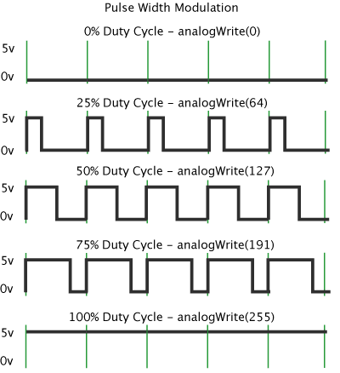
Analog and digitals signals
Analog pins can be used to output pins similarly to digital pins:
Analog output: (http://arduino.cc/en/Tutorial/PWM )
For digital pins (confusing, isn’t it?)
Pulse width modulation
0-255 scale; @500HZ
Only for ~pins: 3,5,6,9,10,11
analogWrite(pin, value)
digitalWrite(A0, HIGH); // A0 is an Analog pin

Slide 9
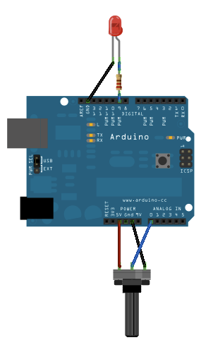
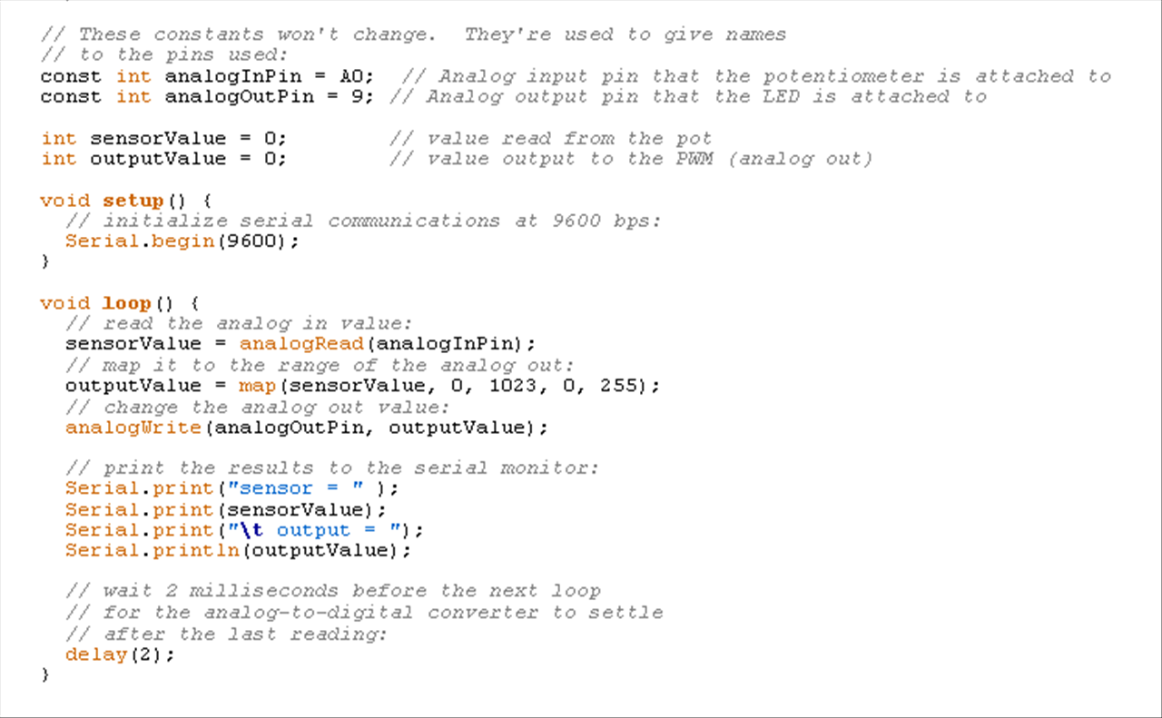
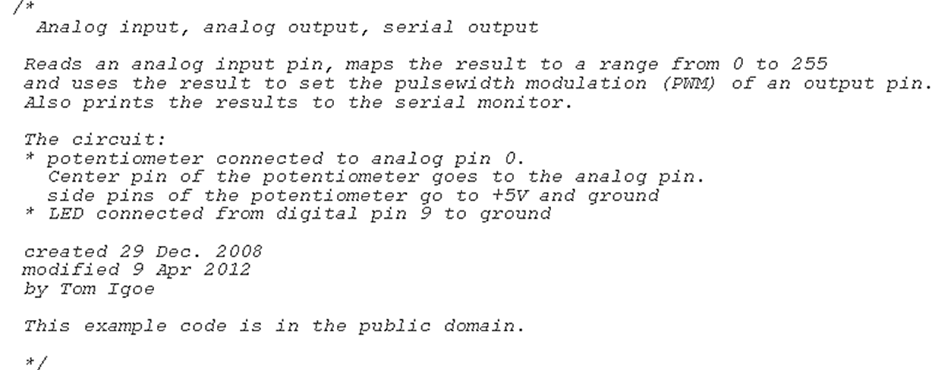
Programing
http://arduino.cc/en/Tutorial/AnalogInOutSerial
http://arduino.cc/en/Reference/HomePage
Analog example:
Code:

Slide 11
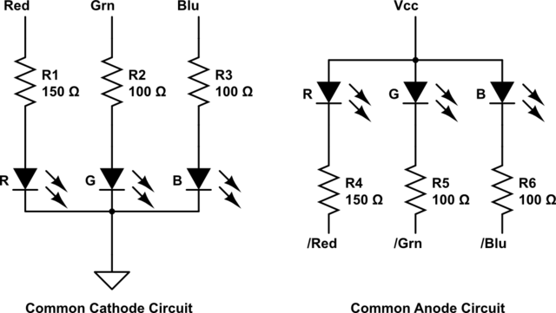
Hands-on (45 min)
Do only the first Q in the hands-on material B1)
3 colour LED
AnalogWrite(PIN,value)
Relevant example:
03 Analog/AnalogInOutSerial

Slide 12
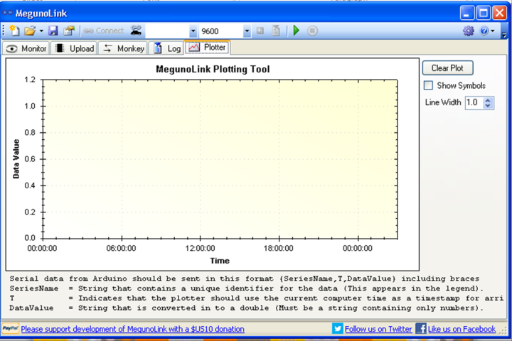
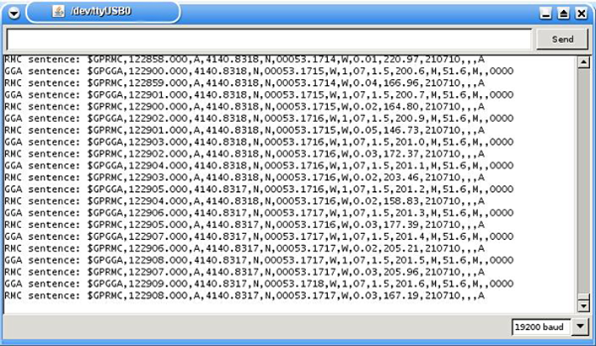
Logging and Graphical view of data
Serial monitor: used to read or send data to the Arduino board
Arduino Serial plot (new feature)
http://www.instructables.com/id/Ultimate-Guide-to-Adruino-Serial-Plotter/step2/Offline-Data-Visulization/
Alternative programs: MegunuLink/python/Matlab

Slide 13
Megulonik
http://www.megunolink.com/megunolink-lite/megunolink-lite-plotting-tool/
Free software for logging, and visual view of data
Syntax: {SeriesName, T, DataValue}
SeriesName is a text string that contains a description of the data. It will be used as a series name in the legend of the plot.
T indicates the x-axis (time)
DataValue contains the data you want to plot.
Arduino Graphing Library

Slide 14
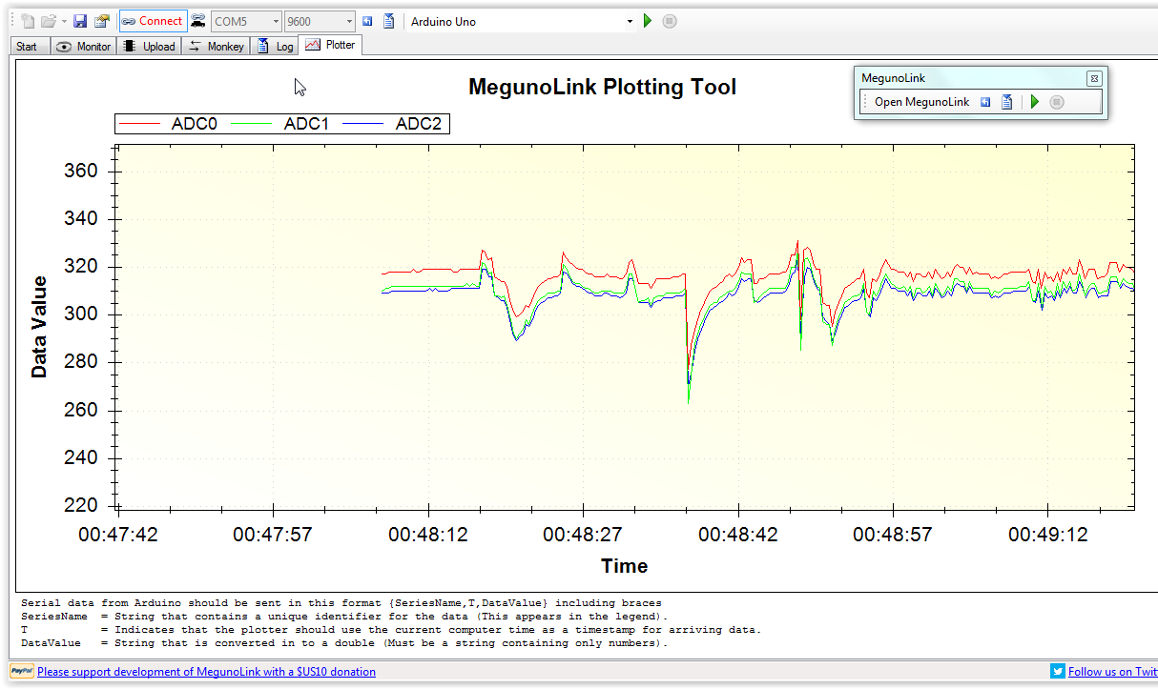
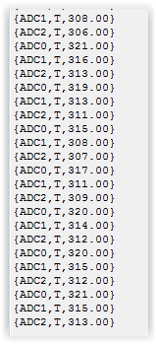
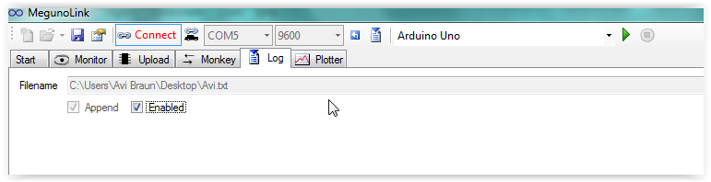
`

Slide 15
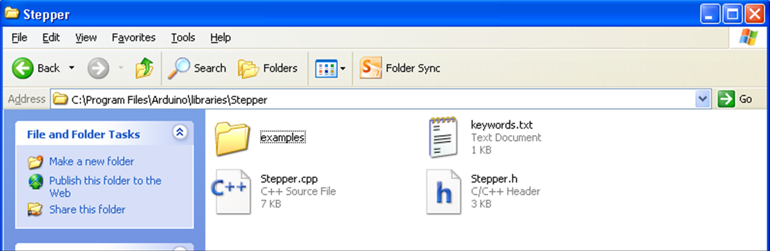
Libraries
http://arduino.cc/en/Guide/Libraries
Libraries installation:
Download the library zip folder
Unzip to your ‘..\arduino\libraries’ folder
Verify that the .cpp and the .h file exists
Useful examples are at the ‘examples’ folder
http://www.megunolink.com/download/GraphSeries.zip
Notes:
Libraries are a collection of code that makes it easy for you to connect to a sensor, display, module, etc. For example, the built-in LiquidCrystal library makes it easy to talk to character LCD displays. There are hundreds of additional libraries available on the Internet for download. The built-in libraries and some of these additional libraries are listed in the reference. To use the additional libraries, you will need to install them.

Slide 16
Hands-on (45 min)
Install the Megunolink library
http://www.megunolink.com/download/GraphSeries.zip
Plot the measured temperature
Save the data to text file

Slide 17
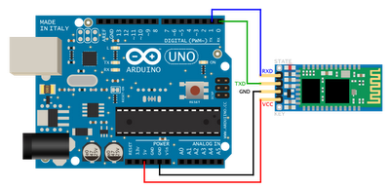
Communication methods:
Ethernet
wifi
GSM
Bluetooth
XBee

Slide 18
Interrupts
Pins 2 and 3 can be set to ‘continually listen’ for a change in state
https://gonium.net/md/2006/12/20/handling-external-interrupts-with-arduino/
https://www.arduino.cc/en/Reference/attachInterrupt

Slide 19
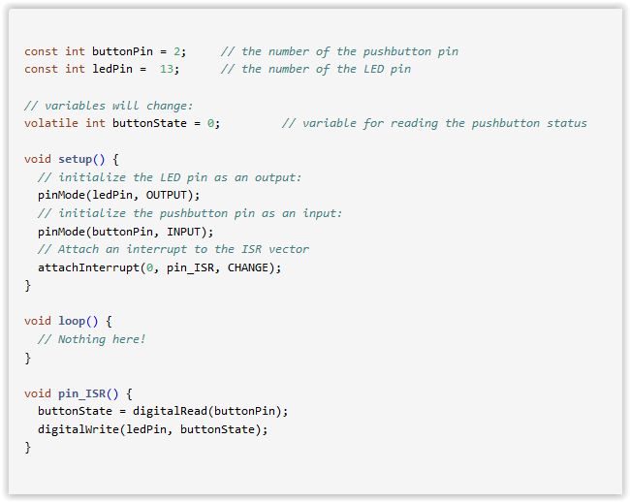

Slide 20
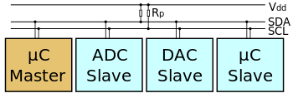
Digital sensors - I2C
http://arduino.cc/en/Reference/wire
http://tronixstuff.com/tutorials/
I2C connection (400kbits):
Allows multiple connection with only two ports
SCL (Serial clock line); SDA (Serial Data – 32 bits digital data)
A5 and A4, respectively, on Arduino Uno
Requires Library: wire.h
Specific address for each connected device

Slide 21
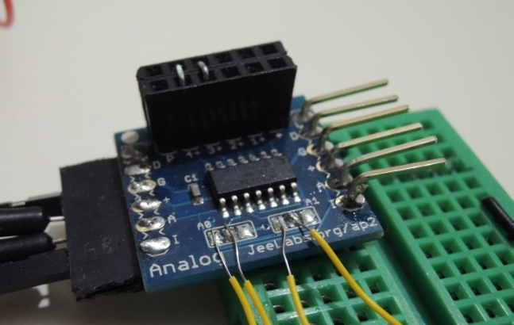
Digital sensors: high resolution ADCs
The need: μV measurement (TCs: for ΔT=1ºC, ΔV=40μV)
Arduino’s integral pins (10 bits): ΔV=1mV
Commercial ADC chips/modules :
MCP3424, ADS1115, ADS1248
Programmable Gain Amplifier (PGA)
Up to 128 (here, up to 8)
Up to 24 bits (here, 16 and 18 )
ΔV as low as 40 nV (here, 2,7μV)
Up to 4 differential inputs (8 ports)
I2C with selectable address
24 TCs with one Arduino board
ΔV=2 μV
ΔV=7 μV

Slide 22
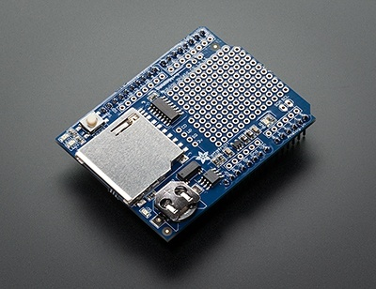
Data logging - SD card
http://arduino.cc/en/Reference/SD
http://learn.adafruit.com/adafruit-micro-sd-breakout-board-card-tutorial/examples
Arduino’s internal memory:
Flash 32k bytes for Sketch storing
SRAM 2k bytes for creating and manipulates variables when the Sketch runs
(EEPROM 1k byte for programmers long term information )
SD card can expand the flash memory (4GB max?)
Requires the Library: SD.h
Open; read; write; remove; mkdir
Communicates using an SPI connection

Slide 23
digital sensors – Serial Peripheral Interface SPI
SPI connection (4Mbits):
Send/receive digital data to/from multiple SPI devices
Require 4 ports (3 common and 1 specific per device):
11;12;13 and 10 (for the Uno board)
Requires Library: SPI.h
http://arduino.cc/en/Reference/SPI
MOSI (Master Out Slave In) - The Master line for sending data to the peripherals,
MISO (Master In Slave Out) - The Slave line for sending data to the master,
SCK (Serial Clock) - The clock pulses which synchronize data transmission generated by the master
and one line specific for every device:
SS (Slave Select) - the pin on each device that the master can use to enable and disable specific devices.

Slide 24
Timing
http://arduino.cc/en/Reference/millis
millis();
Returns the number of milliseconds since the Arduino board began running the current program; will overflow after ~50 days.
An example for creating one second intervals:
const int log_interval=1000; // the required interval in ms
…
…
delay((log_interval -1) - (millis() % log_interval));
Serial.println(what ever you wish to print);
% is the modulus operator

Slide 25
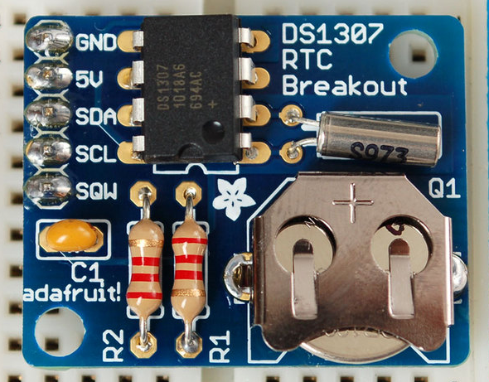
Timing
http://learn.adafruit.com/ds1307-real-time-clock-breakout-board-kit
Real Time Clock – a fancy name for a watch
Will return the time (and date) until its battery dies.
Requires a special library: RTClib
Communicates with Arduino board using I2C connection

Slide 26
Timing
http://arduino.cc/en/Reference/millis
millis();
Returns the number of milliseconds since the Arduino board began running the current program; will overflow after ~50 days.

Slide 27
Next steps with Arduino –
Using Arduino for lab work
?

Slide 28
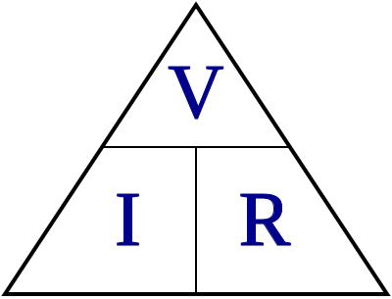
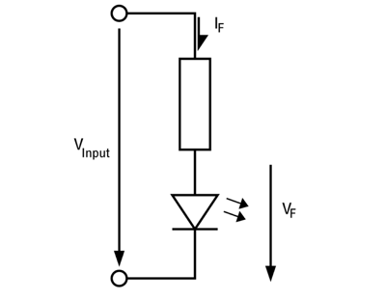

Ohm’s law
I=V/R; (or: V=I R; R=V/I)
The current equals to the voltage divided by the resistance
At short circuit (minimal resistane) the current is very high
We need to add resistors for a safe operation of LEDs:

Slide 29
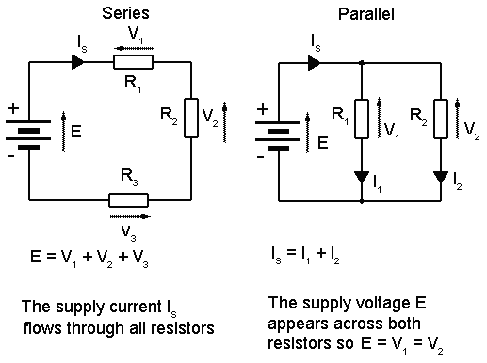
Parallel and series circuits
Adding currents or adding voltage?
Shunt

